Slide 1
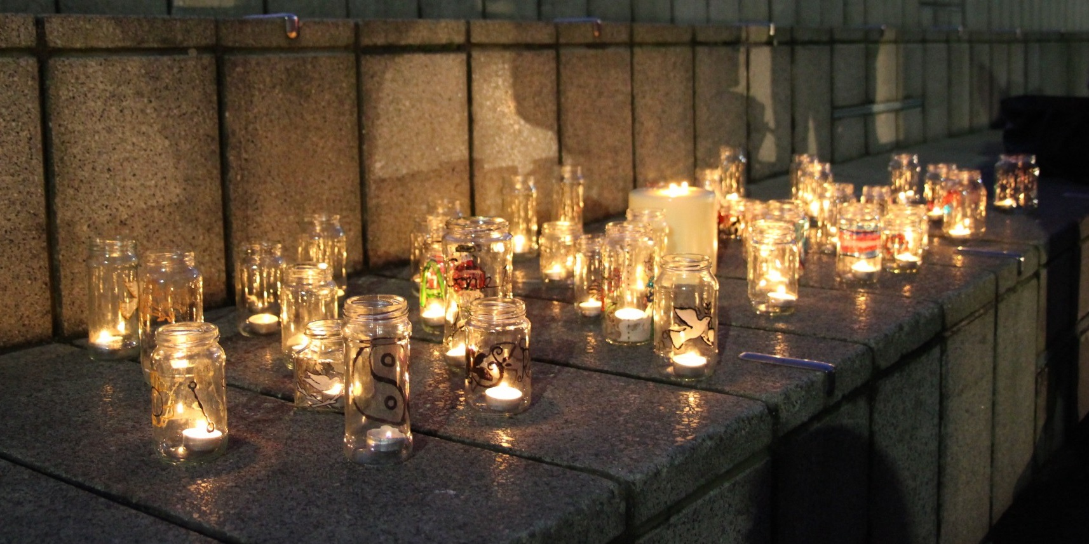
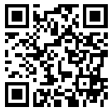
Trans Lives Matter: Remembering Our Dead
Trans Day of Remembrance 2026
https://tdor.translivesmatter.info/

Slide 2
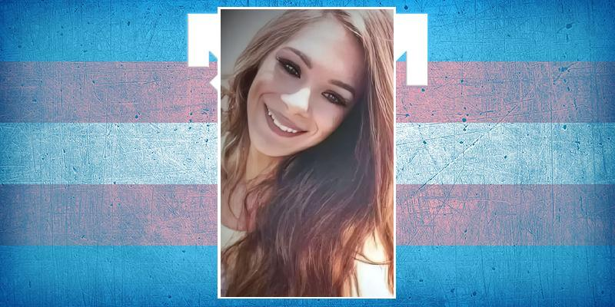
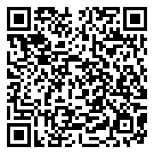

Gabielly Souza da Silva
Age 25
Belo Jardim, Pernambuco (Brazil)
shot. 2 Oct 2025

Slide 3

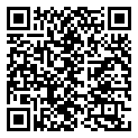
Name Unknown
Tlaquepaque, Jalisco (Mexico)
shot. 3 Oct 2025

Slide 4
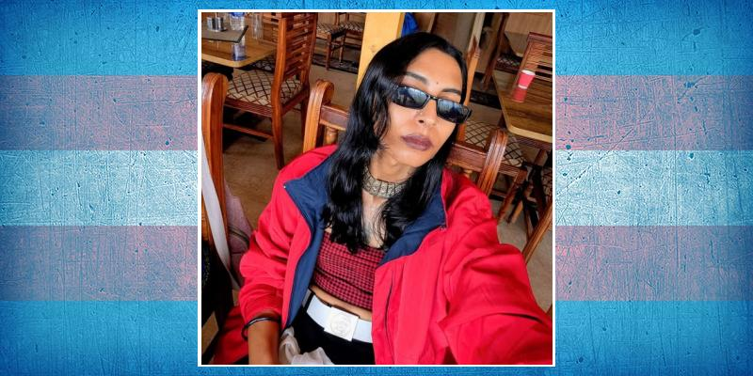
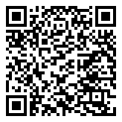
Abeeha
Age 24
Karachi, Sindh (Pakistan)
suicide. 4 Oct 2025

Slide 5
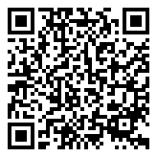
Lois
Age 23
Clichy, Paris (France)
suicide. 4 Oct 2025

Slide 6
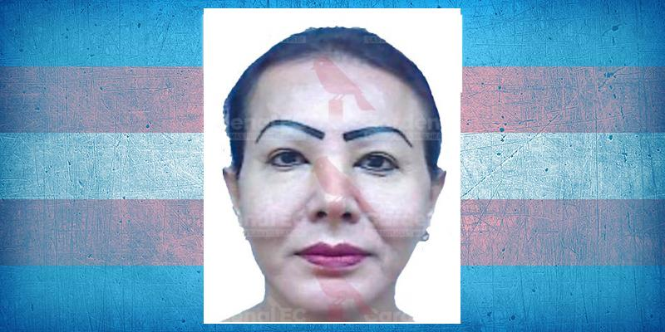
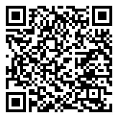
Carolina Chenoa Soto
Machala, El Oro (Ecuador)
strangled. 5 Oct 2025

Slide 7
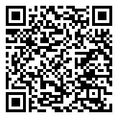
Dandara
Age 30
Uberaba, Minas Gerais (Brazil)
stabbed. 6 Oct 2025

Slide 8
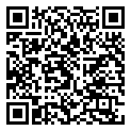
C. P. Acuña
Age 35
Foz do Iguaçu, Paraná (Brazil)
8 Oct 2025

Slide 9
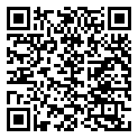
Name Unknown
Age 27-28
Alessandria (Italy)
robbed and murdered. 9 Oct 2025

Slide 10
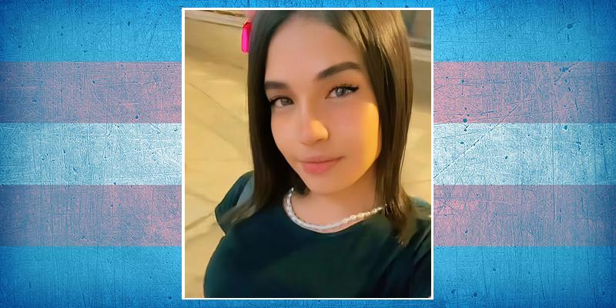
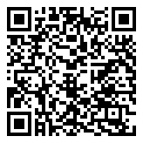
Becky G
Age 25
Guayaquil, Guayas (Ecuador)
shot. 10 Oct 2025

Slide 11
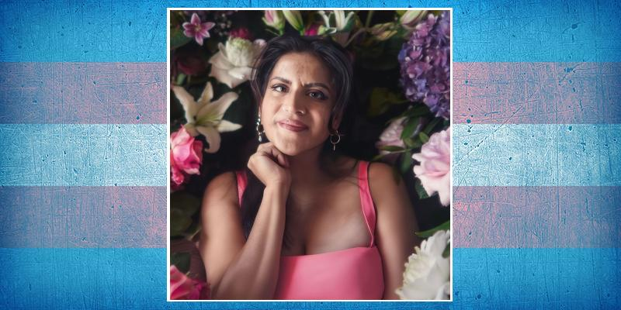
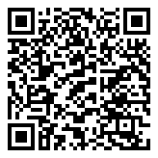
Kika
Age 40
Guayaquil, Guayas (Ecuador)
shot. 12 Oct 2025

Slide 12
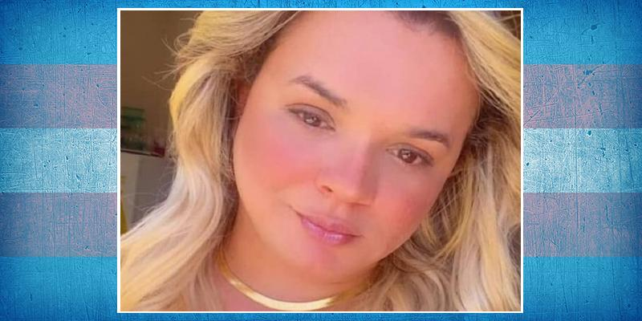
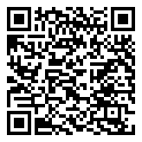
Pâmela Coelho
Age 37
Fortaleza, Ceará (Brazil)
beaten. 13 Oct 2025

Slide 13
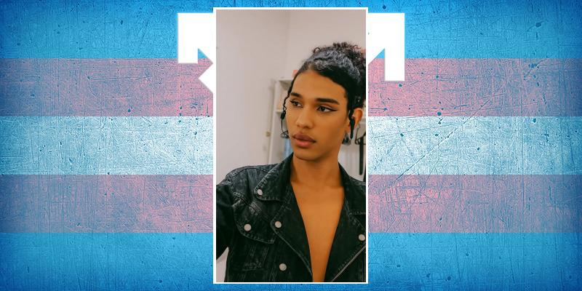
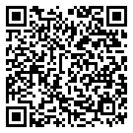
Morgana Clemente Ferreira Silva
Age 19
Cidade de Goiás (Brazil)
stabbed. 14 Oct 2025

Slide 14
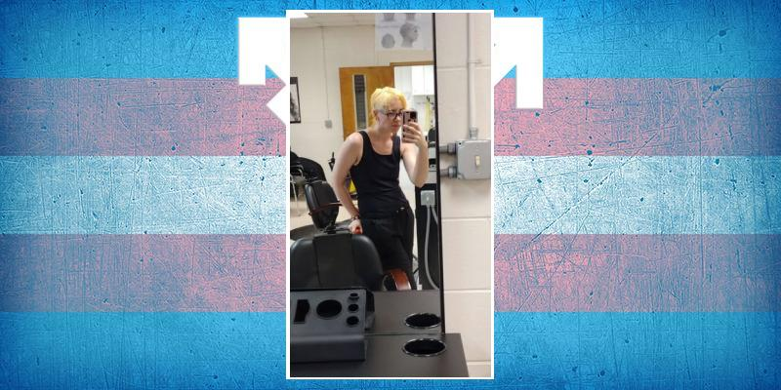
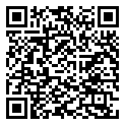
Cormac Robinson
Age 24
Carrollton, Georgia (USA)
shot. 15 Oct 2025

Slide 15
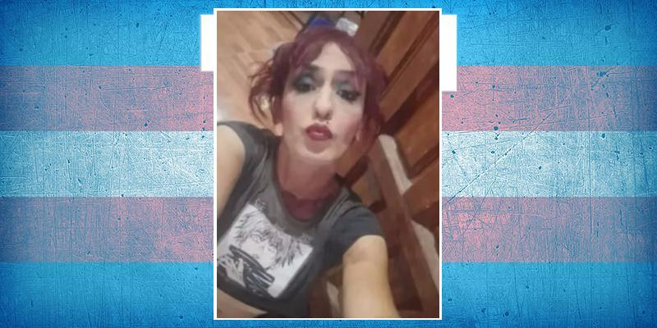
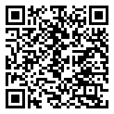
Azul Semeñenko
Age 49
Neuquén (Argentina)
stabbed. 15 Oct 2025

Slide 16
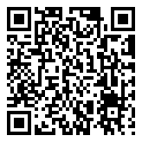
Raju Machh
Jeypore, Odisha (India)
suicide. 15 Oct 2025

Slide 17
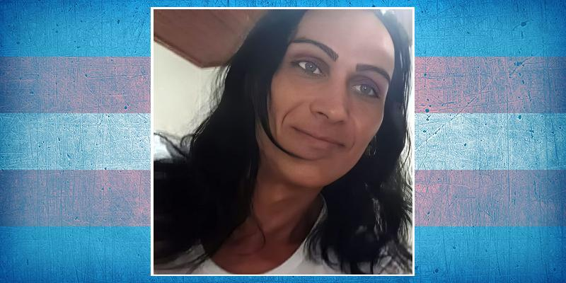
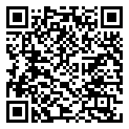
Andressa Bernardes
Age 43
Rio Verde, Goiás (Brazil)
strangled and burnt. 20 Oct 2025

Slide 18
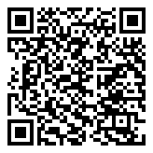
Name Unknown
Cariacica, Espírito Santo (Brazil)
shot. 21 Oct 2025

Slide 19
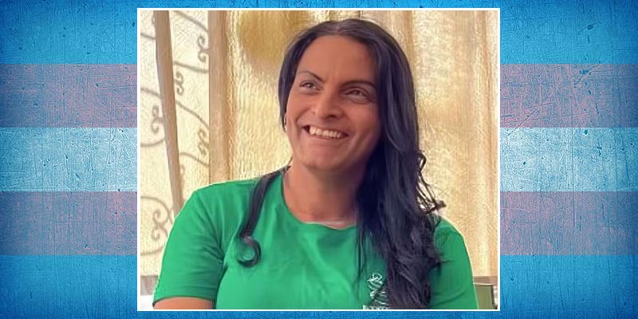
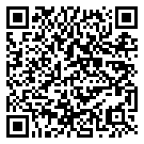
Christina Maciel Oliveira
Age 45
Belo Horizonte, Minas Gerais (Brazil)
beaten. 21 Oct 2025

Slide 20
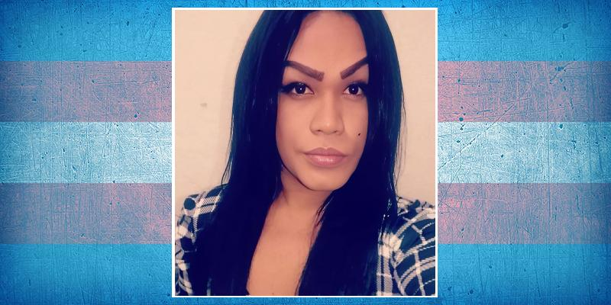
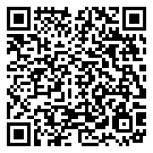
Soraya Kendall Montenegro
Age 34
Manaus, Amazonas (Brazil)
fell. 22 Oct 2025

Slide 21
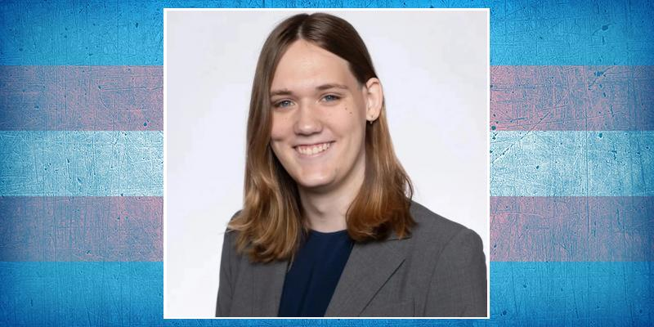
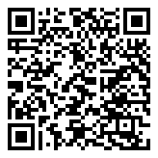
Lia Smith
Age 21
Middlebury, Vermont (USA)
suicide. 23 Oct 2025

Slide 22
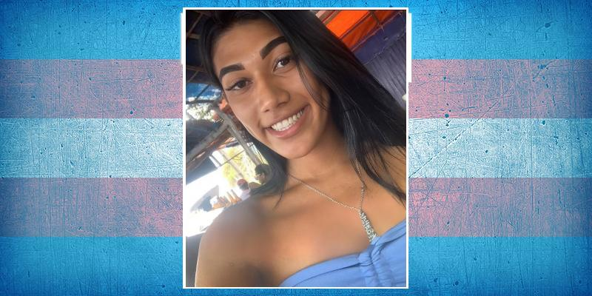
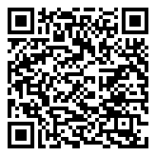
Emilly Sofia
Groaíras, Ceará (Brazil)
shot. 25 Oct 2025

Slide 23
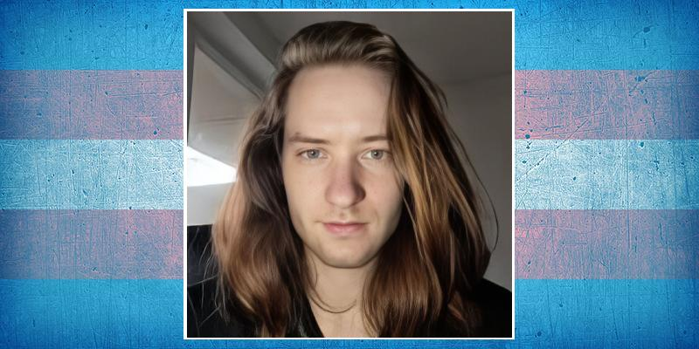
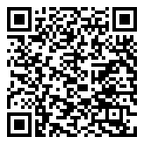
Alik Gerbig
Age 25
Hamburg (Germany)
suicide. 27 Oct 2025

Slide 24
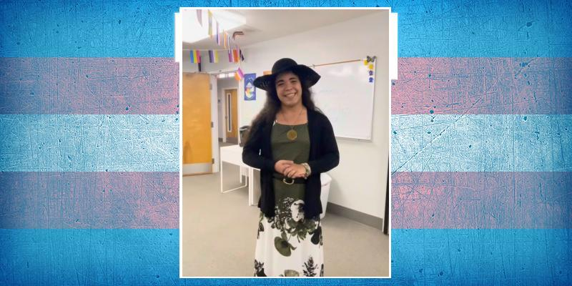
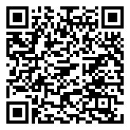
Marisol Payero
Age 22
Kennesaw, Georgia (USA)
suicide. 27 Oct 2025

Slide 25
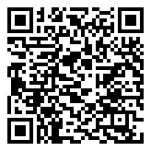
Juana Cecilia ("Ceci")
Age 25-37
León, Guanajuato (Mexico)
shot. 31 Oct 2025

Slide 26
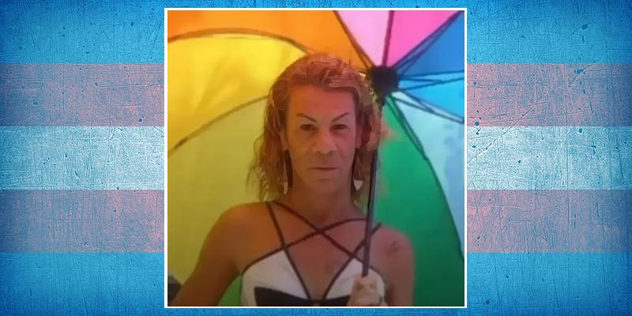
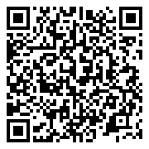
Ladeira Rolim
Age 43
Mogi das Cruzes, São Paulo (Brazil)
1 Nov 2025

Slide 27

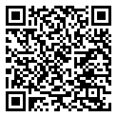
Naomis Redondo Labastida
Age 31
Córdoba (Spain)
fell. 2 Nov 2025

Slide 28
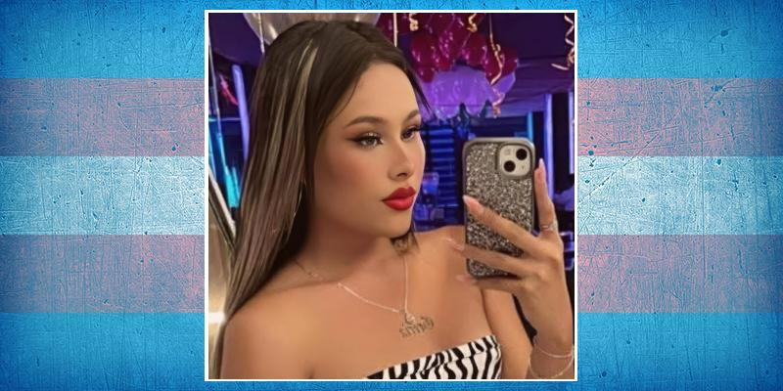
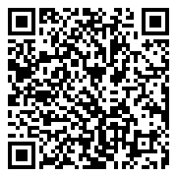
Grecia Nery
Age 19
Tehuacán, Puebla (Mexico)
asphixiated. 4 Nov 2025

Slide 29
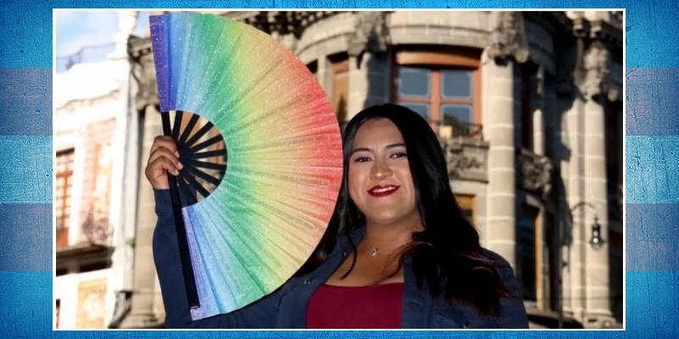
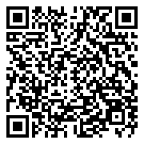
Hannah Fernanda Cervantes
Age 24
Cholula, Puebla (Mexico)
suicide. 4 Nov 2025

Slide 30
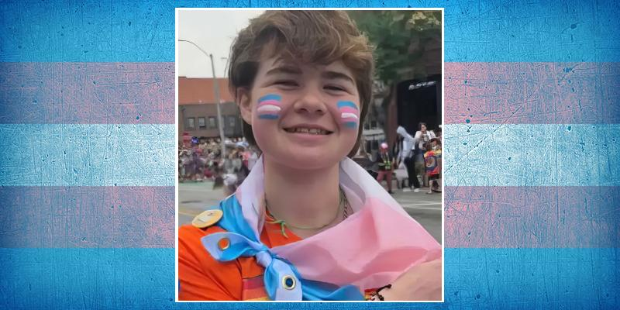

Miles Phipps
Age 15
Urbandale, Iowa (USA)
suicide. 4 Nov 2025

Slide 31


Sasha C.O. Chung Ordóñez
Age 25
Ventanas, Los Ríos (Ecuador)
shot. 8 Nov 2025

Slide 32


Karly
Age 60
Natal, Rio Grande do Norte (Brazil)
beaten. 9 Nov 2025

Slide 33


Alice Martins Alves
Age 33
Belo Horizonte, Minas Gerais (Brazil)
beaten. 9 Nov 2025

Slide 34


Débora ("La Pajarita")
Bolívar (Ecuador)
tortured and murdered. 9 Nov 2025

Slide 35

Dollar
Lakki Marwat, Khyber Pakhtunkhwa (Pakistan)
shot. 9 Nov 2025

Slide 36

Zakir Khan
Age 34
Lakki Marwat, Khyber Pakhtunkhwa (Pakistan)
shot. 9 Nov 2025

Slide 37


Sol Millacura Hernández Márquez
Valparaíso (Chile)
suicide. 11 Nov 2025

Slide 38


Francisco Herrera ("La Tite")
Age 49
Caicara de Maturín, Monagas (Venezuela)
beaten and stabbed. 12 Nov 2025

Slide 39

Bianca Zanotto Filho
Age 41
Lages, Santa Catarina (Brazil)
suffocated. 13 Nov 2025

Slide 40


Glenda Beatriz
Age 21
Abreu e Lima, Pernambuco (Brazil)
stabbed. 14 Nov 2025

Slide 41


Girlalala
Age 21
Tampa, Florida (USA)
shot. 15 Nov 2025

Slide 42

Khkula
Age 21-25
Nowshera, Khyber Pakhtunkhwa (Pakistan)
shot. 17 Nov 2025

Slide 43


Dusk Sienna Mead
Age 32
Milton Keynes, Buckinghamshire (United Kingdom)
17 Nov 2025

Slide 44


Bella
Age 22
Canberra, Australian Capital Territory (Australia)
suicide. 17 Nov 2025

Slide 45


Evelin Baten
Guatemala
18 Nov 2025

Slide 46


Treinti
Ciudad Evita, Buenos Aires (Argentina)
run over. 18 Nov 2025

Slide 47

Clarisse
Age 26
Koudougou, Boulkiemdé (Burkina Faso)
tortured. 20 Nov 2025

Slide 48

Afsana
Hyderabad, Telangana (India)
suicide. 20 Nov 2025

Slide 49


Jaiden Rae Detwiler ("Jade")
Age 28
Düsseldorf, North Rhine-Westphalia (Germany)
suicide. 21 Nov 2025

Slide 50


Nora Jane Jenneman
Age 25
Salt Lake City, Utah (USA)
21 Nov 2025

Slide 51

Heena
Age 22
Hyderabad, Telangana (India)
suicide. 23 Nov 2025

Slide 52

Navneetha
Age 24
Hyderabad, Telangana (India)
suicide. 25 Nov 2025

Slide 53


Lilith Hailey
Age 32
Wise County, Virginia (USA)
unlawfully killed. 26 Nov 2025

Slide 54


Tomiris Kusainova
Age 28
Tbilisi (Georgia)
26 Nov 2025

Slide 55


Daniela Fernanda Arias
Age 34
Rosario de Lerma, Salta (Argentina)
died in custody. 26 Nov 2025

Slide 56

Markella Roasa
Age 45
Vancouver, British Columbia (Canada)
beaten. 28 Nov 2025

Slide 57

Name Unknown
Age 27
Pauini, Amazonas (Brazil)
shot. 28 Nov 2025

Slide 58


Poyraz
Age 28
Sincan, Ankara (Turkey)
suspicious death. 1 Dec 2025

Slide 59


Bianca Ferreira da Rocha Pimenta
Age 30
Bucharest (Romania)
run over. 2 Dec 2025

Slide 60


Betyna Barros ("Bê")
Age 33
Nova Mutum, Mato Grosso (Brazil)
shot. 3 Dec 2025

Slide 61

Amanda Honorato da Silva
Age 42
Guarujá, São Paulo (Brazil)
stabbed. 3 Dec 2025

Slide 62

Pari
Age 25
Ghaziabad, Uttar Pradesh (India)
suicide. 4 Dec 2025

Slide 63

Sweety
Age 22
Solapur, Maharashtra (India)
suicide. 4 Dec 2025

Slide 64


Gabriely Silva de Jesus
Age 21
Várzea Grande, Mato Grosso (Brazil)
murdered. 5 Dec 2025

Slide 65


Rhianna Alves
Age 18
Luís Eduardo Magalhães, Bahia (Brazil)
strangled. 6 Dec 2025

Slide 66

Name Unknown
Age 37
France
suicide. 6 Dec 2025

Slide 67


Sharol Victoria
Bogóta, Distrito Capital (Colombia)
run over. 7 Dec 2025

Slide 68


Katie Bocon
Age 51
Reading, Berkshire (United Kingdom)
suicide. 9 Dec 2025

Slide 69


Madeline Adelaide Moore ("Mads")
Age 27
Louisville, Kentucky (USA)
suicide. 9 Dec 2025

Slide 70


Rebeca
Age 34
Juazeiro do Norte, Ceará (Brazil)
shot. 12 Dec 2025

Slide 71

Aicha
Age 35
Ouagadougou, Kadiogo (Burkina Faso)
died in custody. 20 Dec 2025

Slide 72


Paulinha do Paraguaçu
Age 51
Santo Estevão, Bahia (Brazil)
shot. 21 Dec 2025

Slide 73

Kariane
Sobral, Ceará (Brazil)
shot. 23 Dec 2025

Slide 74

Jenifer López Pérez Amaya ("La China")
Age 32
Matagalpa (Nicaragua)
stabbed. 24 Dec 2025

Slide 75


Peu
Age 41
Brejo da Madre de Deus, Pernambuco (Brazil)
stabbed. 25 Dec 2025

Slide 76


Danny Siplin
Age 33
Rochester, New York (USA)
possible suicide. 26 Dec 2025

Slide 77


Rosaline Mattaboni ("Rose")
Age 22
Millersville, Pennsylvania (USA)
28 Dec 2025

Slide 78


Shayne Cook
Age 48
Goulburn, New South Wales (Australia)
stabbed. 30 Dec 2025

Slide 79


Yuliza Orozco
La Ceja, Antioquia (Colombia)
shot. 30 Dec 2025

Slide 80


Luva Noemí Madera Covarrubias
Age 35
Puerto Vallarta, Jalisco (Mexico)
run over. 1 Jan 2026

Slide 81


Sthepanny Cassiano da Silva
Age 25
São João Batista, Santa Catarina (Brazil)
stabbed. 1 Jan 2026

Slide 82


Bijli
Peshawar, Khyber Pakhtunkhwa (Pakistan)
shot. 2 Jan 2026

Slide 83


Kemilly Bittencourt
Três Rios, Rio de Janeiro (Brazil)
suffocated and stabbed. 2 Jan 2026

Slide 84


Jade Roberts
Age 25
Houston, Texas (USA)
shot. 2 Jan 2026

Slide 85


Catia
Age 20
Bogotá, Distrito Capital (Colombia)
beaten. 3 Jan 2026

Slide 86

Shilpa
Age 36
Chennai, Tamil Nadu (India)
beaten. 3 Jan 2026

Slide 87


Aitana
Age 22
Ciudad de México, CDMX (Mexico)
stabbed. 4 Jan 2026

Slide 88


Raylla Oliveira
São José de Ribamar, Maranhão (Brazil)
beaten. 6 Jan 2026

Slide 89

Name Unknown
Porto Alegre, Rio Grande do Sul (Brazil)
shot. 7 Jan 2026

Slide 90


Esra Koca
Age 40
Ankara (Turkey)
possible suicide. 7 Jan 2026

Slide 91


Jullyana Freitas Leite
Age 40
Feira de Santana, Bahia (Brazil)
shot. 8 Jan 2026

Slide 92


Saman Abdi
Iran
shot. 8 Jan 2026

Slide 93


Heilly Marcela
Cali, Valle del Cauca (Colombia)
9 Jan 2026

Slide 94


Nima Abbasi
Age 23
Isfahan (Iran)
shot. 9 Jan 2026

Slide 95

Alia
Sadiqabad, Punjab (Pakistan)
tortured. 10 Jan 2026

Slide 96


"La Venezolana"
Daule, Guayas (Ecuador)
murdered. 12 Jan 2026

Slide 97


"La Peli"
Age 31
Valledupar, Cesar (Colombia)
shot. 15 Jan 2026

Slide 98

Estefanía Montiel
Age 25
Granada (Nicaragua)
beaten. 15 Jan 2026

Slide 99


Ivy Jones
Age 28
Salt Lake City, Utah (USA)
16 Jan 2026

Slide 100


Julissa
Age 31
Cercado de Lima (Peru)
stabbed. 19 Jan 2026

Slide 101

Claudia Priscila Galván
Age 53
Quilmes Oeste, Buenos Aires (Argentina)
stabbed. 20 Jan 2026

Slide 102

Vicky
La Esperanza, Trujillo (Peru)
beaten. 22 Jan 2026

Slide 103


Yeye
Santander de Quilichao, Cauca (Colombia)
22 Jan 2026

Slide 104


Valentina Taiga Azul Delú
Age 36
La Plata, Buenos Aires (Argentina)
suicide. 23 Jan 2026

Slide 105


Flávia Mendonça
Age 37
Grossos, Rio Grande do Norte (Brazil)
shot. 25 Jan 2026

Slide 106


Magaly Vaz
London (United Kingdom)
25 Jan 2026

Slide 107


Bianca Costureira
Age 50
Porto Calvo, Alagoas (Brazil)
stabbed. 26 Jan 2026

Slide 108


May Pollard
Age 16
Boise, Idaho (USA)
suicide. 27 Jan 2026

Slide 109


Zoé Plaza
Age 16
Paris (France)
suicide. 27 Jan 2026

Slide 110

Mutharasi
Age 21
Virudhunagar, Tamil Nadu (India)
suicide. 29 Jan 2026

Slide 111


Madeline Cassandra Stensrud ("Maddie")
Erie, Colorado (USA)
suicide. 30 Jan 2026

Slide 112


Irlana
Salvador, Bahia (Brazil)
shot. 31 Jan 2026

Slide 113


Anjali
Bhubaneswar, Odisha (India)
stabbed. 1 Feb 2026

Slide 114


Dalezka Cedeño Ochoa
Jambelí, El Oro (Ecuador)
shot. 1 Feb 2026

Slide 115


Beatriz Ganzarolli
Age 23
Salvador, Bahia (Brazil)
shot. 2 Feb 2026

Slide 116


Sheila Costa
Age 35
São Paulo (Brazil)
shot. 2 Feb 2026

Slide 117


Sol Melisa Coria
Age 43
Termas de Río Hondo, Santiago del Estero (Argentina)
HIV. 3 Feb 2026

Slide 118

Nafisa
Age 26
Ziniare, Oubritenga (Burkina Faso)
suicide. 4 Feb 2026

Slide 119


Deyran Palacios
Age 15
Ibarra (Ecuador)
tortured, raped and stabbed. 5 Feb 2026

Slide 120


Ágata Mendes
Age 18
Santo Antônio da Platina, Paraná (Brazil)
stabbed. 7 Feb 2026

Slide 121


Joëlla Mahitoga
Age 45
Nouméa, Nouvelle-Calédonie (France)
beaten. 7 Feb 2026

Slide 122


Ares Navarrete
Age 32
Chilpancingo, Guerrero (Mexico)
8 Feb 2026

Slide 123


Anastasia Matić
Age 19
Biel, Bern (Switzerland)
8 Feb 2026

Slide 124


Ashtyn Tice
Age 17
Dothan, Alabama (USA)
suicide. 9 Feb 2026

Slide 125


Rylie Autumn Heart
Age 40
Homestead, Pennsylvania (USA)
suicide. 10 Feb 2026

Slide 126

Beatrice
Age 14
Vittoria, Ragusa, Sicily (Italy)
suicide. 11 Feb 2026

Slide 127


Emanuelle Silva ("Manu")
Age 17
Coqueiro Seco, Alagoas (Brazil)
decapitated. 11 Feb 2026

Slide 128

Name Unknown
Janakpur, Madhesh (Nepal)
12 Feb 2026

Slide 129


Natasha Lucas do Nascimento ("Gabi")
Age 27
Vitória, Espírito Santo (Brazil)
shot. 15 Feb 2026

Slide 130

Name Unknown
Melcho Ocampo, Estado de México (Mexico)
beaten. 16 Feb 2026

Slide 131


Gabriella dos Santos ("Gabi")
Age 27
Campo Grande, Mato Grosso do Sul (Brazil)
shot. 16 Feb 2026

Slide 132


Constanza Sánchez Tolosa ("Madre Constanza")
Age about 60
Bogotá, Distrito Capital (Colombia)
murdered. 18 Feb 2026

Slide 133


Suhasini
Age 29
Ballari, Karnataka (India)
suspected homicide. 18 Feb 2026

Slide 134


Vannesa Luciana ("La Luki")
Cúcuta, Norte de Santander (Colombia)
beaten. 18 Feb 2026

Slide 135


Aydan
Baku (Azerbaijan)
stabbed. 19 Feb 2026

Slide 136

Gadir
Age 29
Havana, La Habana (Cuba)
suicide. 20 Feb 2026

Slide 137


Samanta Gomes de Araújo
Age 32
Trindade, Pernambuco (Brazil)
stabbed. 21 Feb 2026

Slide 138


Gisella Estefanía Granda Ochoa
Age 46-49
Pasaje, El Oro (Ecuador)
stabbed. 23 Feb 2026

Slide 139


Melany Hernández
Age 29
Lérida, Tolima (Colombia)
shot. 26 Feb 2026

Slide 140


Kimberly Joseline Ramos Beltran ("Fanny")
Age about 30
Cuernavaca, Morelos (Mexico)
shot. 26 Feb 2026

Slide 141


Arielle Source Love
Age 50
San Diego, California (USA)
26 Feb 2026

Slide 142


Naome
Tibau do Sul, Rio Grande do Norte (Brazil)
stabbed. 27 Feb 2026

Slide 143

Renu Devi
Age 30
Bagaha, Bihah (India)
possible suicide. 28 Feb 2026

Slide 144


Name Unknown
Cuenca, Azuay (Ecuador)
shot. 28 Feb 2026

Slide 145


Flavia Cunha
Age 42
Divinópolis, Minas Gerais (Brazil)
shot. 2 Mar 2026

Slide 146


Jadyn Kimsel
Age 16
Howell, Michigan (USA)
suicide. 3 Mar 2026

Slide 147


Keira Rose Winters
Age 18
York, North Yorkshire (United Kingdom)
suicide. 3 Mar 2026

Slide 148


Thea Lourdes Masica
Age 24
Plymouth, Minnesota (USA)
suicide. 3 Mar 2026

Slide 149


Daniela
Age 30
Manizales, Caldas (Colombia)
shot. 5 Mar 2026

Slide 150


Nayrobi Flores Arcia
Age 27
Ciudad de México, CDMX (Mexico)
tortured and stabbed. 6 Mar 2026

Slide 151


Giseel Guzmán Aguilar Centeno
Age 31
Comayaguela, Distrito Capital (Honduras)
shot. 13 Mar 2026

Slide 152


Shyyell Diamond Sanchez-Mccray (¨Mabel¨)
Age 42
Petersburg, Virginia (USA)
shot. 13 Mar 2026

Slide 153


Sigrid Taylor
Age 19
Canterbury, Kent (United Kingdom)
suicide. 14 Mar 2026

Slide 154


Erika Droual
Age 24
Paris (France)
suicide. 15 Mar 2026

Slide 155

Jeanne
Age 30
Ouagadougou, Kadiogo (Burkina Faso)
tortured and murdered. 15 Mar 2026

Slide 156


Suellen Jalala Ferreira de Brito
Age 30
Araras, São Paulo (Brazil)
murdered. 18 Mar 2026

Slide 157


Vaiolet Trochez
Santander de Quilichao, Cauca (Colombia)
stabbed. 19 Mar 2026

Slide 158


Karla
Age 34
Naranjal, Guayas (Ecuador)
shot. 20 Mar 2026

Slide 159


Yannis Boumelah
Age 38
Saint-Brieuc, Côtes-d'Armor (France)
suicide. 20 Mar 2026

Slide 160


Nina
Age 29
Baden-Württemberg (Germany)
suicide. 21 Mar 2026

Slide 161


Solange Herrera
Choluteca (Honduras)
shot. 23 Mar 2026

Slide 162

Name Unknown
Age 30-40
São Paulo (Brazil)
beaten. 23 Mar 2026

Slide 163


Sydney Lou Walden
Age 30
Lancaster, Pennsylvania (USA)
suicide. 24 Mar 2026

Slide 164


Estrelinha de Souza
Age 28
Barra, Bahia (Brazil)
stabbed. 27 Mar 2026

Slide 165


Estrella Vázquez Cruz
Age 36
Azoyú, Guerrero (Mexico)
shot. 28 Mar 2026

Slide 166


Tawan Neves
Cabo Frio, Rio de Janeiro (Brazil)
shot. 29 Mar 2026

Slide 167


Renata Almeida Dutra
Age 43
São Paulo (Brazil)
31 Mar 2026

Slide 168


"La Zamantha"
Age 30
Culiacán, Sinaloa (Mexico)
shot. 1 Apr 2026

Slide 169

Name Unknown
Cancún, Quintana Roo (Mexico)
stabbed. 2 Apr 2026

Slide 170

Amelia Caporale
Age about 20
Milan, Lombardy (Italy)
suicide. 4 Apr 2026

Slide 171


Sara
Peshawar, Khyber Pakhtunkhwa (Pakistan)
shot. 5 Apr 2026

Slide 172


Sabrina Loza
Age 40
Tlayacapan, Morelos (Mexico)
shot. 6 Apr 2026

Slide 173


Morgan Sage Seltzer
Age 25
Boston, Massachusetts (USA)
suicide. 7 Apr 2026

Slide 174


Suzane Almeida ("Suzy")
Guaraí, Tocantins (Brazil)
shot. 7 Apr 2026

Slide 175


Claudia Gabriela Gómez ("Caí")
Age 33-34
Posadas, Misiones (Argentina)
beaten. 8 Apr 2026

Slide 176


Davonta Curtis
Age 31
Chicago, Illinois (USA)
beaten. 9 Apr 2026

Slide 177


Daniela Martínez Silva
Age 24
Morelia, Michoacán (Mexico)
murdered. 11 Apr 2026

Slide 178


Daniella Analee Escobedo
Age 34
Las Vegas, Nevada (USA)
12 Apr 2026

Slide 179


Danielle Spillman
Age 74
San Francisco, California (USA)
run over. 13 Apr 2026

Slide 180


Arya
Age 19
Ankara (Turkey)
suicide. 13 Apr 2026

Slide 181


Vica Monteros
Age 44
Córdoba (Argentina)
stabbed. 15 Apr 2026

Slide 182

La China
Age 32
Quevedo, Los Rios (Ecuador)
shot. 15 Apr 2026

Slide 183

Sarabjit Kaur
Age 37
Bathinda, Punjab (India)
stabbed. 16 Apr 2026

Slide 184

Sherry Yue ("玥餅 Yuèbǐng")
Age 26
Taiwan
suicide. 16 Apr 2026

Slide 185


Dayana Gallegos
San José del Cabo, Baja California Sur (Mexico)
beaten. 16 Apr 2026

Slide 186


Aleanna Royal Belcher
Age 31
Binghamton, New York (USA)
stabbed. 17 Apr 2026

Slide 187


Morgen Batten
Age 32
Swindon, Wiltshire (United Kingdom)
organ failure. 17 Apr 2026

Slide 188


Paris Harris
Age 21
Dallas, Texas (USA)
shot. 17 Apr 2026

Slide 189


Lucas RedBeard Knapp ("Luca")
Age 39
Candy Kitchen, New Mexico (USA)
shot. 18 Apr 2026

Slide 190


Fernanda Palacios
Age 27
Cintalapa de Figueroa, Chiapas (Mexico)
shot. 18 Apr 2026

Slide 191


Kai Dana Sorem
Age 26
Toboso, Negros Occcidental (Philippines)
shot. 20 Apr 2026

Slide 192


Christina Maria Huerta Iraci
Age 57
Aztec, New Mexico (USA)
20 Apr 2026

Slide 193

Caroba
Punto de Ayutla, Querétaro (Mexico)
murdered. 21 Apr 2026

Slide 194


Valeria Micaela Benítez
Age 36
Virrey del Pino, Buenos Aires (Argentina)
stabbed. 22 Apr 2026

Slide 195


Valeska Barboza
Age 36
Brasília, Distrito Federal (Brazil)
stabbed. 25 Apr 2026

Slide 196


Mallika
Challavaripalle, Andhra Pradesh (India)
kidnapped and murdered. 26 Apr 2026

Slide 197


M.
Age 20
Germany
suicide. 27 Apr 2026

Slide 198


Lanessa Rodriguez
Age 33
Fort Pierce, Florida (USA)
shot. 28 Apr 2026

Slide 199


Cecilia Cardona
Age 47
Gualeguay, Entre Rios (Argentina)
run over. 1 May 2026

Slide 200


Dayana Pavón
Nacaome, Valle (Honduras)
hanged. 2 May 2026

Slide 201


Marcus Noah Mejía
Age 22
Juticalpa, Olancho (Honduras)
shot. 3 May 2026

Slide 202


Bianka Acsa Rosa da Fonseca
Age 36
Curvelo, Minas Gerais (Brazil)
burned. 3 May 2026

Slide 203


Emanuelle Samira Fernandes Neta
Age 27
Mossoró, Rio Grande do Norte (Brazil)
murdered. 4 May 2026

Slide 204

Sherazade
Posorja, Guayas (Ecuador)
shot. 4 May 2026

Slide 205


Hailey "Spot" Singleton
Age 29
Dunnellon, Florida (USA)
shot. 5 May 2026

Slide 206


Agatha
Age 18
Mossóro, Rio Grande do Norte (Brazil)
5 May 2026

Slide 207


Mariana Ballesteros Restrepo
Age 19
Bello, Antioquia (Colombia)
shot. 7 May 2026

Slide 208

Radhika Jadhav
Age 35
Nagpur, Maharashtra (India)
suicide. 7 May 2026

Slide 209


Daniela Rave Rico
Age 23
Angelópolis, Antioquia (Colombia)
shot. 7 May 2026

Slide 210


Esthefanía Delgado ("Fanny")
Age 27
Mexicaltzingo, Estado de México (Mexico)
stabbed. 7 May 2026

Slide 211


Fiorella Rodríguez
Age 28
Manta, Manabi (Ecuador)
7 May 2026

Slide 212


Luana Faria da Silva Oliveira
Age 29
Mogi das Cruzes, São Paulo (Brazil)
strangled. 9 May 2026

Slide 213

Isabelle Arcanjo
Age 52
Tibau do Sul, Rio Grande do Norte (Brazil)
kidnapped and murdered. 9 May 2026

Slide 214

Angélica
Age 25
São Luís, Maranhão (Brazil)
shot. 10 May 2026

Slide 215


Juniper Blessing
Age 19
Seattle, Washington (USA)
stabbed. 10 May 2026

Slide 216

Mastani/Dewaani
Age 25-28
Bannu, Khyber Pakhtunkhwa (Pakistan)
stabbed. 10 May 2026

Slide 217

João
Recife, Pernambuco (Brazil)
shot. 11 May 2026

Slide 218

Celine Ribeiro Gois
Age 39
Fortaleza, Ceará (Brazil)
shot. 11 May 2026

Slide 219


Doloresse
Age about 35
Yaoundé, Mfoundi (Cameroon)
throat cut. 12 May 2026

Slide 220


Tatiana Cerrato Pineda
Age 29
Tegucigalpa, Distrito Central (Honduras)
burned. 12 May 2026

Slide 221


Ashley Bernal García
Texcalyacac, Estado de México (Mexico)
burned. 13 May 2026

Slide 222


Yulixa Consuelo Toloza
Age 52
Bogotá, Distrito Capital (Colombia)
13 May 2026

Slide 223


Kelly Laura
Nova Andradina, Mato Grosso do Sul (Brazil)
shot. 16 May 2026

Slide 224

Mahi
Cumilla, Chittagong (Bangladesh)
burned. 17 May 2026

Slide 225


Erykah Caldwell
Age 41
New York City (USA)
throat cut. 17 May 2026

Slide 226

Name Unknown
João Pessoa, Paraíba (Brazil)
beaten. 17 May 2026

Slide 227

Riana
Age 23
Uberaba, Minas Gerais (Brazil)
shot. 17 May 2026

Slide 228


Kimberli Durán García
Age 33
Figueres, Girona (Spain)
stabbed. 19 May 2026

Slide 229


Nathaniel Potts
Age 16
Raleigh, Illinois (USA)
shot. 20 May 2026

Slide 230

T. D. Crawford
Age 33
Charlotte, North Carolina (USA)
21 May 2026

Slide 231


Tutu Santos Barbosa
Itapororoca, Paraíba (Brazil)
beaten. 21 May 2026

Slide 232


Dominik Jastrzębski
Age 21
Lewin Kłodzki, Kłodzko County (Poland)
suicide. 21 May 2026

Slide 233


Taing Simeng ("Leilei")
Age 35
Chbar Ampov, Phnom Penh (Cambodia)
stabbed. 23 May 2026

Slide 234


Jasmine
Toronto, Ontario (Canada)
murdered. 23 May 2026

Slide 235


Leia Trysiss Ali
Age 35
Las Vegas, Nevada (USA)
murdered. 24 May 2026

Slide 236

Chandini
Age 35
Greater Noida, Uttar Pradesh (India)
beaten. 24 May 2026

Slide 237


Murry Foust
Wilder, Kentucky (USA)
possible suicide. 24 May 2026

Slide 238


Michelle Jiménez
Armenia, Sonsonate (El Salvador)
suicide. 25 May 2026

Slide 239


Persia Amarra Conway
Age 33
Houston, Texas (USA)
murdered. 25 May 2026

Slide 240


Reina Mengueña
Age 26
Santo Domingo, Chontales (Nicaragua)
stabbed. 25 May 2026

Slide 241

Yasmin
Age 26
Raipura Upzilla, Narsingdi (Bangladesh)
throat cut. 25 May 2026

Slide 242


Maria Vanúbia
Franco da Rocha, São Paulo (Brazil)
27 May 2026

Slide 243


Maât
Age 25
Paris (France)
suicide. 28 May 2026

Slide 244


Laura Jane Keneddy
Age 74
London (United Kingdom)
31 May 2026

Slide 245


Rubí Mejía
Ciudad de México, CDMX (Mexico)
beaten. 2 Jun 2026

Slide 246


Deniz Soydam
Mersin, Akdeniz (Turkey)
suicide. 2 Jun 2026

Slide 247


Bianca dos Santos
Age 40-50
Bragança Paulista, São Paulo (Brazil)
3 Jun 2026

Slide 248


Natália dos Anjos Molina
Age 33
Campo Grande, Mato Grosso do Sul (Brazil)
shot. 5 Jun 2026

Slide 249


Adhara Andrea Benavides Álvarez ("Abi Bexo")
Age 31-32
Dosquebradas, Risaralda (Colombia)
stabbed. 7 Jun 2026

Slide 250


Alexa Álvarez Ríos
Age 29
Ezeiza, Buenos Aires (Argentina)
suicide. 7 Jun 2026

Slide 251


Marlow Trottie
Age 35
Alexandria, Louisiana (USA)
murdered. 8 Jun 2026

Slide 252


Paulina Blandón Villada ("La Chapola")
La Ceja, Antioquia (Colombia)
8 Jun 2026

Slide 253


Kalena "Peaches" Croskey
Age 32
Birmingham, Alabama (USA)
suicide. 11 Jun 2026

Slide 254

Fabíola
Age 31
Campinas, São Paulo (Brazil)
beaten. 12 Jun 2026

Slide 255


Laura Fülöp
Age 19
Budapest (Hungary)
suicide. 12 Jun 2026

Slide 256

Kayleigh
Age 20
Nashville, Tennessee (USA)
suicide. 13 Jun 2026

Slide 257

Apoutchou
Age 27
Ouagadougou, Kadiogo (Burkina Faso)
torture. 15 Jun 2026

Slide 258

Name Unknown
Manaus, Amazonas (Brazil)
strangled. 17 Jun 2026

Slide 259


Sasha Dayanara Troya Ramos
Age 40
Palenque, Los Ríos (Ecuador)
shot. 17 Jun 2026

Slide 260


Patti Wilson
Age 31
Grand Junction, Colorado (USA)
shot. 19 Jun 2026

Slide 261


Bella Lutap
Age 20
Zaragoza, Nueva Ecija (Philippines)
strangled. 19 Jun 2026

Slide 262


Bianca Narrara de Morais
Age 21
Piracema, Minas Gerais (Brazil)
stabbed. 21 Jun 2026

Slide 263


La’Daijah Walters
Age 32
Mobile, Alabama (USA)
shot. 22 Jun 2026

Slide 264


Bruna
Moju, Pará (Brazil)
shot. 23 Jun 2026

Slide 265


Vanessinha Menelli
Age 37
Corumbá, Mato Gosso do Sul (Brazil)
23 Jun 2026

Slide 266


Asia Williams
Age 38
Baltimore, Maryland (USA)
shot. 23 Jun 2026

Slide 267


Lizzy Rachel
Age 29
Buenos Aires (Argentina)
murdered. 24 Jun 2026

Slide 268


Michelangelo Andreoni
Age 24
Camaiore, Tuscany (Italy)
shot. 24 Jun 2026

Slide 269


Etchika Pollex
Age 70
Vienna (Austria)
stabbed. 25 Jun 2026

Slide 270


Caro
Zarzal, Valle del Cauca (Colombia)
shot. 25 Jun 2026

Slide 271


Victoria Cruz
Age 79
New York City (USA)
liver cancer. 25 Jun 2026

Slide 272

Rachell
Buenos Aires (Argentina)
26 Jun 2026

Slide 273


Steisy Malibú
Ciénaga, Magdalena (Colombia)
tortured, murdered and burned. 26 Jun 2026

Slide 274


Leila Sawan
Age 26
Damascus (Syria)
26 Jun 2026

Slide 275


Nicoll Torres
Villavicencio, Meta (Colombia)
shot. 28 Jun 2026

Slide 276


Ansel Blaszkow
Age 24
Cazenovia, New York (USA)
suicide. 2 Jul 2026

Slide 277

Wal
Age 45
Contagem, Minas Gerais (Brazil)
stabbed. 4 Jul 2026

Slide 278


Jayla McGee
Age 19
Belle Glade, Florida (USA)
shot. 5 Jul 2026

Slide 279


Salome Padilla
Olanchito, Yoro (Honduras)
murdered. 7 Jul 2026

Slide 280

Name Unknown
Age 25-30
Medellín, Antioquia (Colombia)
stabbed. 8 Jul 2026

Slide 281


Heypril Daniela Peralta
Guatemala
8 Jul 2026

Slide 282


Merve Yılmazeli
Age 40
Istanbul (Turkey)
hit and run. 9 Jul 2026

Slide 283


Meeshi
Age about 25
Peshawar, Khyber Pakhtunkhwa (Pakistan)
shot. 13 Jul 2026

Slide 284


Teddy S. Federico
Age 32
Veruela, Agusan del Sur (Philippines)
murdered. 15 Jul 2026

Slide 285

Vega Mojarro
Age 45-50
Mexicali, Baja California (Mexico)
beaten. 16 Jul 2026

Slide 286

Queta Palafox
Age 58
Ciudad de México, CDMX (Mexico)
murdered. 17 Jul 2026

Slide 287


Rayla Elle Ojeda-Wells
Age 29
Jacksonville, Florida (USA)
suicide. 18 Jul 2026

Slide 288


Vitória ("Vicky")
Simões Filho, Bahia (Brazil)
beaten and shot. 19 Jul 2026

Slide 289


Samantha Rivas
Agua Prieta, Sonora (Mexico)
murdered. 21 Jul 2026

Slide 290


Lorena Raissa Souza
Age 25
Garanhuns, Pernambuco (Brazil)
murdered. 22 Jul 2026

Slide 291


Mike Hooves
Age 33-34
Calgary, Alberta (Canada)
breast cancer. 22 Jul 2026

Slide 292


Shakira
Age 24
Cotija de la Paz, Michoacán (Mexico)
shot. 23 Jul 2026

Slide 293


Ale Rous Montero ("La Escubidu")
Age 26
Ica (Peru)
shot. 25 Jul 2026

Slide 294


Cristel Soto Landa ("La Rabiosa")
Age 38
Misantla, Veracruz (Mexico)
26 Jul 2026

Slide 295


Betty Benito
Age 23
Malaybalay City, Bukidnon (Philippines)
murdered. 27 Jul 2026

Slide 296


Luisa Cecilia Lightbourn Muñoz
Age 24
Ciudad Jiménez, Chihuahua (Mexico)
beaten. 29 Jul 2026

Slide 297


Alexa Bernabé Valadez
Age 18
Iguala de la Independencia, Guerrero (Mexico)
stabbed. 30 Jul 2026

Slide 298


Tabatha Lavinny
Teresina, Piauí (Brazil)
shot. 2 Aug 2026

Slide 299


Mavis Joshie
Bengaluru, Karnataka (India)
suicide. 3 Aug 2026

Slide 300


Raely Braz da Silva
Age 29
Camaragibe, Pernambuco (Brazil)
stabbed and burned. 4 Aug 2026

Slide 301


Denise Foster
Age 55
Halawa, Hawaii (USA)
beaten and strangled. 4 Aug 2026

Slide 302


Juju Nadeau
Age 21
Portland, Maine (USA)
stabbed. 5 Aug 2026

Slide 303

Mirza Shoukat Baig
Age 30
Ferozwala, Punjab (Pakistan)
stabbed. 7 Aug 2026

Slide 304


Justine Jameelia Evangelista
Age 17
Paarl, Western Cape (South Africa)
stabbed. 9 Aug 2026

Slide 305


Kimberlyn Molina
Age 35
Marbella, Málaga (Spain)
stabbed. 10 Aug 2026

Slide 306


Jang Caes Macawili
Age 17
Cebu City (Philippines)
shot. 10 Aug 2026

Slide 307


Karina Isabela Meliandi
Age 58
Quilmes Oeste, Buenos Aires (Argentina)
murdered. 10 Aug 2026

Slide 308


Gabriela Denisse Banach
Age 47
Rosario, Santa Fe (Argentina)
beaten. 11 Aug 2026

Slide 309


Jessica Núñez
Age 44
Villa Nueva, Córdoba (Argentina)
stabbed. 13 Aug 2026

Slide 310


Laura
Quevedo, Los Ríos (Ecuador)
dismembered. 14 Aug 2026

Slide 311


Dmitry Menyaev
Age 21
Batumi, Adjara (Georgia)
15 Aug 2026

Slide 312

Name Unknown
Benito Juarez, Guerrero (Mexico)
16 Aug 2026

Slide 313


Jhené Cordelia Audrict
Age 21
St Louis, Missouri (USA)
shot. 17 Aug 2026

Slide 314

Duda
Age 36
Colombo, Paraná (Brazil)
18 Aug 2026

Slide 315

Ellen Nascimento de Lima
Age 31
Recife, Pernambuco (Brazil)
18 Aug 2026

Slide 316


Asma
Rangia, Assam (India)
stabbed. 19 Aug 2026

Slide 317


Kethallyn Fantyny
Age 37
São Bernardo do Campo, São Paulo (Brazil)
decapitated. 21 Aug 2026

Slide 318


Devi
Age 27
Bengaluru, Karnataka (India)
stabbed. 22 Aug 2026

Slide 319

Mayra Rosalía
Age 40
Zamora, Michoacán (Mexico)
shot. 22 Aug 2026

Slide 320


Mackley Anaya Cáceres Maldonado
Age 22
San Antonio del Táchira (Venezuela)
shot. 23 Aug 2026

Slide 321


Maryna Colucci
Age 34
Jacui, Minas Gerais (Brazil)
murdered. 25 Aug 2026

Slide 322


Maria Alessandra Roza Silva
Age 46
Tracuateua, Pará (Brazil)
beaten. 27 Aug 2026

Slide 323


Kayra Kamilly
Age 33
Guarujá, São Paulo (Brazil)
beaten. 27 Aug 2026

Slide 324


Aleja Cuesta
Age 17
Medellín, Antioquia (Colombia)
tortured and murdered. 29 Aug 2026

Slide 325


Luciana Centeno
Age 40
Jesús María, Cordóba (Argentina)
suicide. 29 Aug 2026

Slide 326


Luan
Age 17
Penápolis, São Paulo (Brazil)
asphixiated and burned. 30 Aug 2026

Slide 327


Madonna Isabella Webber Saldanha da Silva
Age 46
Caxias do Sul, Rio Grande do Sul (Brazil)
shot. 31 Aug 2026

Slide 328


Yoisi Villalta
Tacuba, Ahuachapán (El Salvador)
4 Sep 2026

Slide 329


Mousumi
Age 52
Chattogram, Chittagong (Bangladesh)
stabbed. 5 Sep 2026

Slide 330

Laisa de Oliveira Silva
Belém, Pará (Brazil)
shot. 5 Sep 2026

Slide 331

Lorena
Belém, Pará (Brazil)
stabbed. 6 Sep 2026

Slide 332


Danitza Cortes Cruza
Age 32
Santa Cruz (Bolivia)
stabbed. 6 Sep 2026

Slide 333

Marijune Bug-ot
Age 42
Consolacion, Cebu (Philippines)
beaten. 6 Sep 2026

Slide 334


Voss Barclay
Age 34
Westminster, Colorado (USA)
possible suicide. 7 Sep 2026

Slide 335

Mariposa
Age about 35
Cali, Valle del Cauca (Colombia)
stabbed. 7 Sep 2026

Slide 336


Renata Santos
Age 31
Itaperuna, Rio de Janeiro (Brazil)
stabbed. 9 Sep 2026

Slide 337


Sophie Lee
Age 27
Baltimore, Maryland (USA)
shot. 11 Sep 2026

Slide 338


Roxxy Vanessa Astaiza
Popayán, Cauca (Colombia)
stabbed. 17 Sep 2026

Slide 339


Lynn Ann Childers
Age 18
Arbutus, Maryland (USA)
suicide. 21 Sep 2026

Slide 340


Cristin Bueno
Age 21
Dasmariñas City, Cavite (Philippines)
shot. 22 Sep 2026

Slide 341

Andressa Natalino dos Santos
Age 42
São Paulo (Brazil)
shot. 23 Sep 2026

Slide 342

Sunanda
Age 28
Siddipet, Telangana (India)
suicide. 24 Sep 2026

Slide 343

Paloma
Age 27
Manaus, Amazonas (Brazil)
shot. 25 Sep 2026

Slide 344


Jonathan McKinsey
Age 40
Dublin, California (USA)
shot. 26 Sep 2026

Slide 345

Cafú
Age 34
San Ramón de la Nueva Orán, Salta (Argentina)
burned. 26 Sep 2026

Slide 346

Gabrielle ("Bananinha")
Age 30
Viana, Espírito Santo (Brazil)
decapitated. 27 Sep 2026

Slide 347


Kaden Hammond
Age 15
Elora, Ontario (Canada)
suicide. 27 Sep 2026

Slide 348


Fernanda Ballmant
Age 55
São José dos Campos, São Paulo (Brazil)
28 Sep 2026

Slide 349


Max Bolduc
Age 26
Waterbury, Vermont (USA)
suicide. 30 Sep 2026

Slide 350


Edgar Nicolle
Age about 35
Buenavista, Sucre (Colombia)
beaten. 30 Sep 2026

Slide 351
Trans Lives Matter
SAY THEIR NAMES

